Slide 1
CYCLING
ISTANBUL TECHNICAL UNIVERSITY
BLG 361E – DATABASE MANAGEMENT SYSTEM
TERM PROJECT
2015 – 2016, FALL
Tunahan Erkoyuncu 150110047
Alper Kocabıyık 150110018
Cem Yusuf Aydoğdu 150120251
Emre Can Agatay 150110023
İsmail Serhat Buga 150110004

Slide 2
What is the CYCLING? Cycling can be defined simply an information system of cycling sport with all contents. Add/Delete/Update/Search Add Player Player Comment Team Team Comment Tournament Tournament Comment Country City Comment City Accommodation Comment Accommodation Admin Author Place

Slide 3
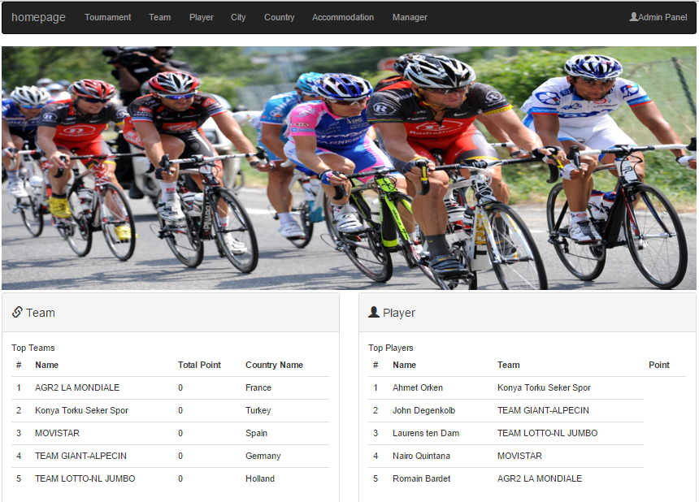
HOMEPAGE

Slide 4
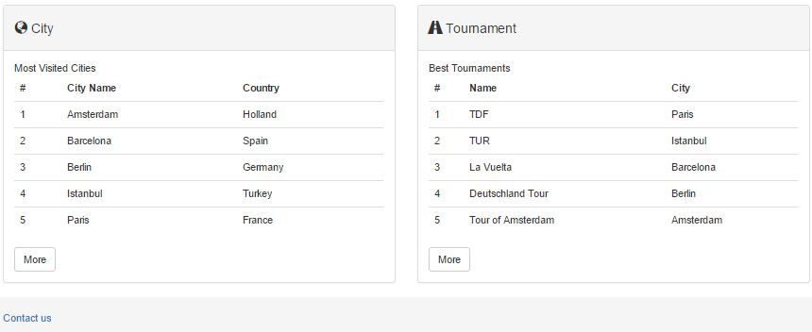
Homepage Bottom

Slide 5
NON-ADMIN USER
Non-admin user can access the Cycling functions throgh the list at the top menu .
User able to perform following task
Add Comment
Search Data
See Comment

Slide 6
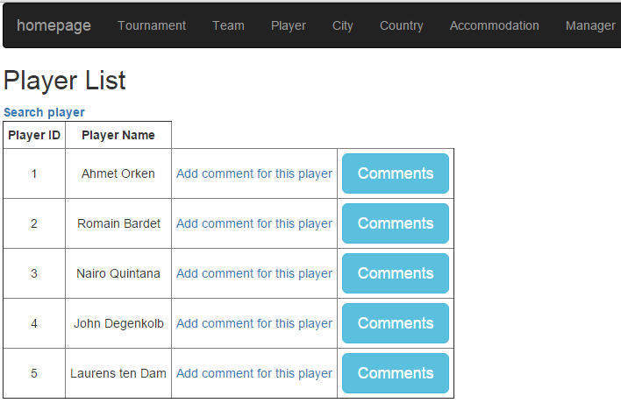
Non-admin user can use search function and add comment in Player List

Slide 7
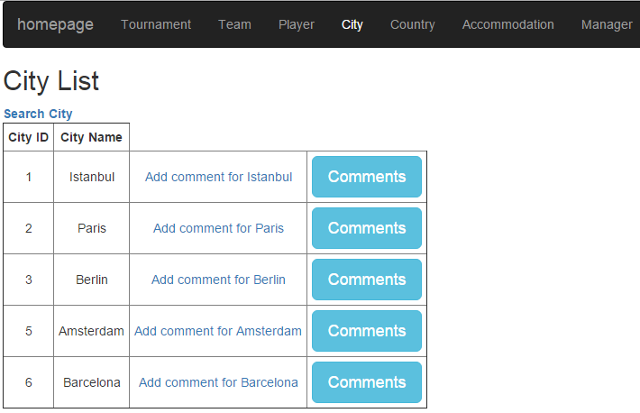
Non-admin user can use search function and add comment in City List

Slide 8
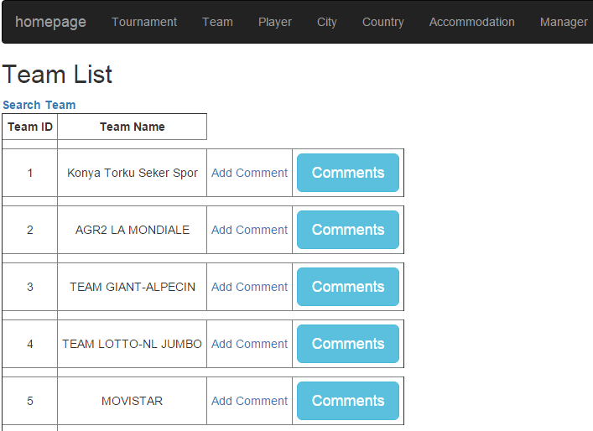
Non-admin user can use search function and add comment in Team List

Slide 9
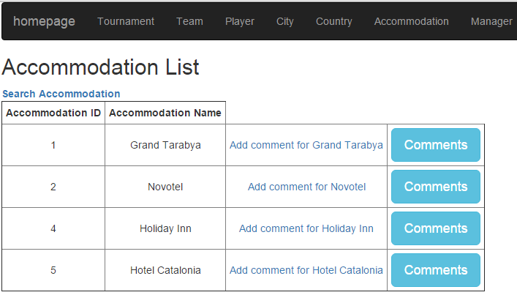
Non-admin user can use search function and add comment in Accommodation List

Slide 10
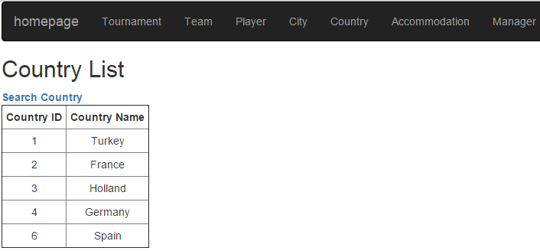
Non-admin user can use search function in Country List

Slide 11
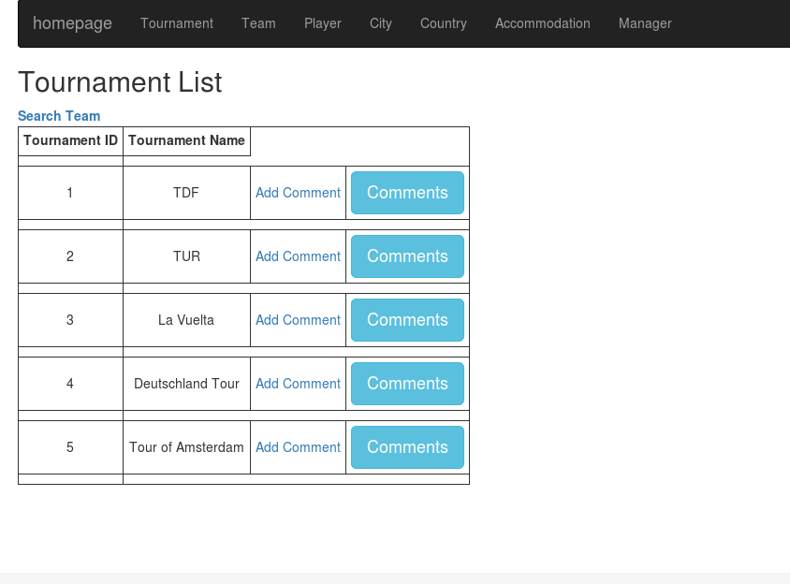
Non-admin user can use search function and add comment in Tournament List

Slide 12
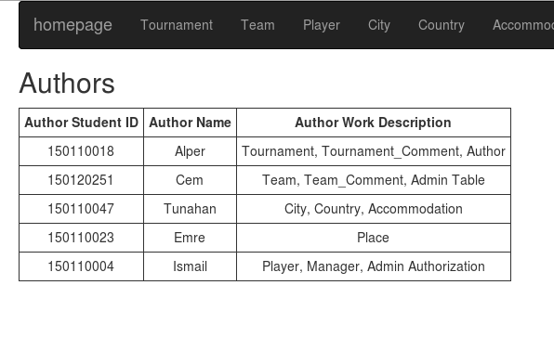
Non-admin user can see the author features in Author List

Slide 13
ADMIN USER
Admin user can access the Cycling functions throgh the list at the top menu.
User able to perform following task
Add, Delete, Update, Search for All Data
Add Comment to Actors
Admin Login/Logout

Slide 14
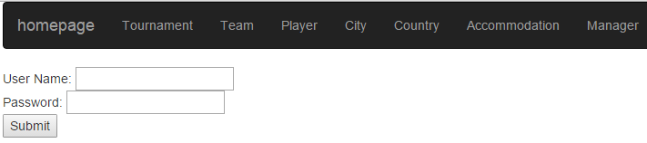
Admin Login

Slide 15
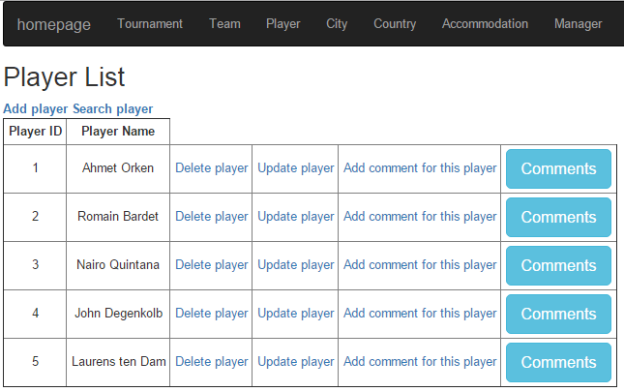
Admin user can use add, delete, update, search functions and add comment in Player List

Slide 16
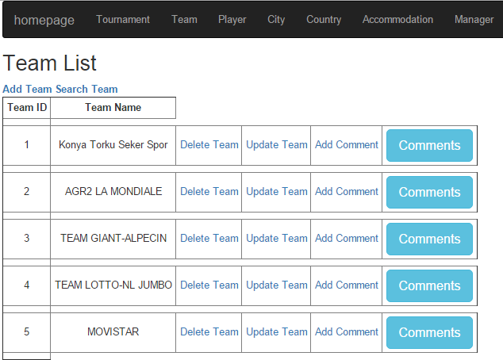
Admin user can use add, delete, update, search functions and add comment in Team List

Slide 17
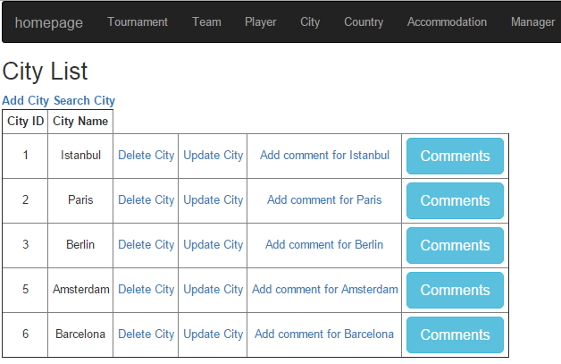
Admin user can use add, delete, update, search functions and add comment in City List

Slide 18
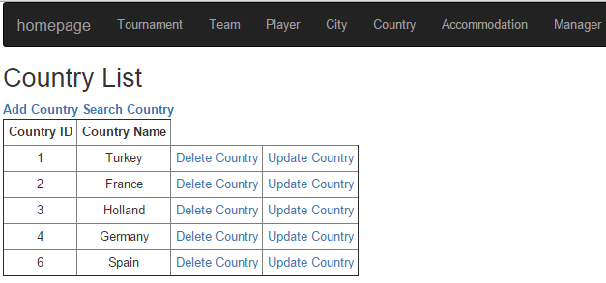
Admin user can use add, delete, update, search functions and add comment in Country List

Slide 19
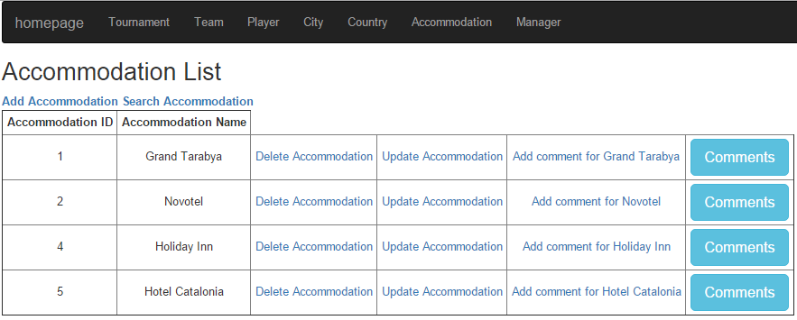
Admin user can use add, delete, update, search functions and add comment in Accommodation List

Slide 20
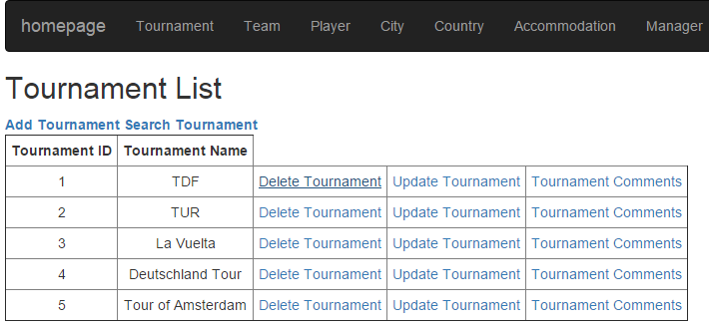
Admin user can use add, delete, update, search functions and add comment in Tournament List

Slide 21
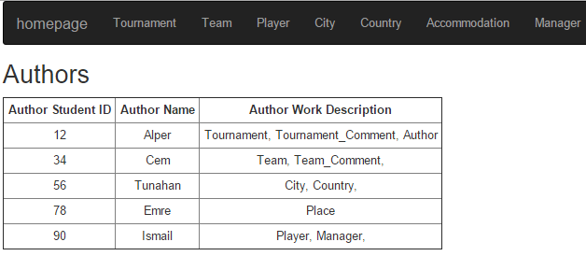
Admin user can see the author features in Author List

Slide 22
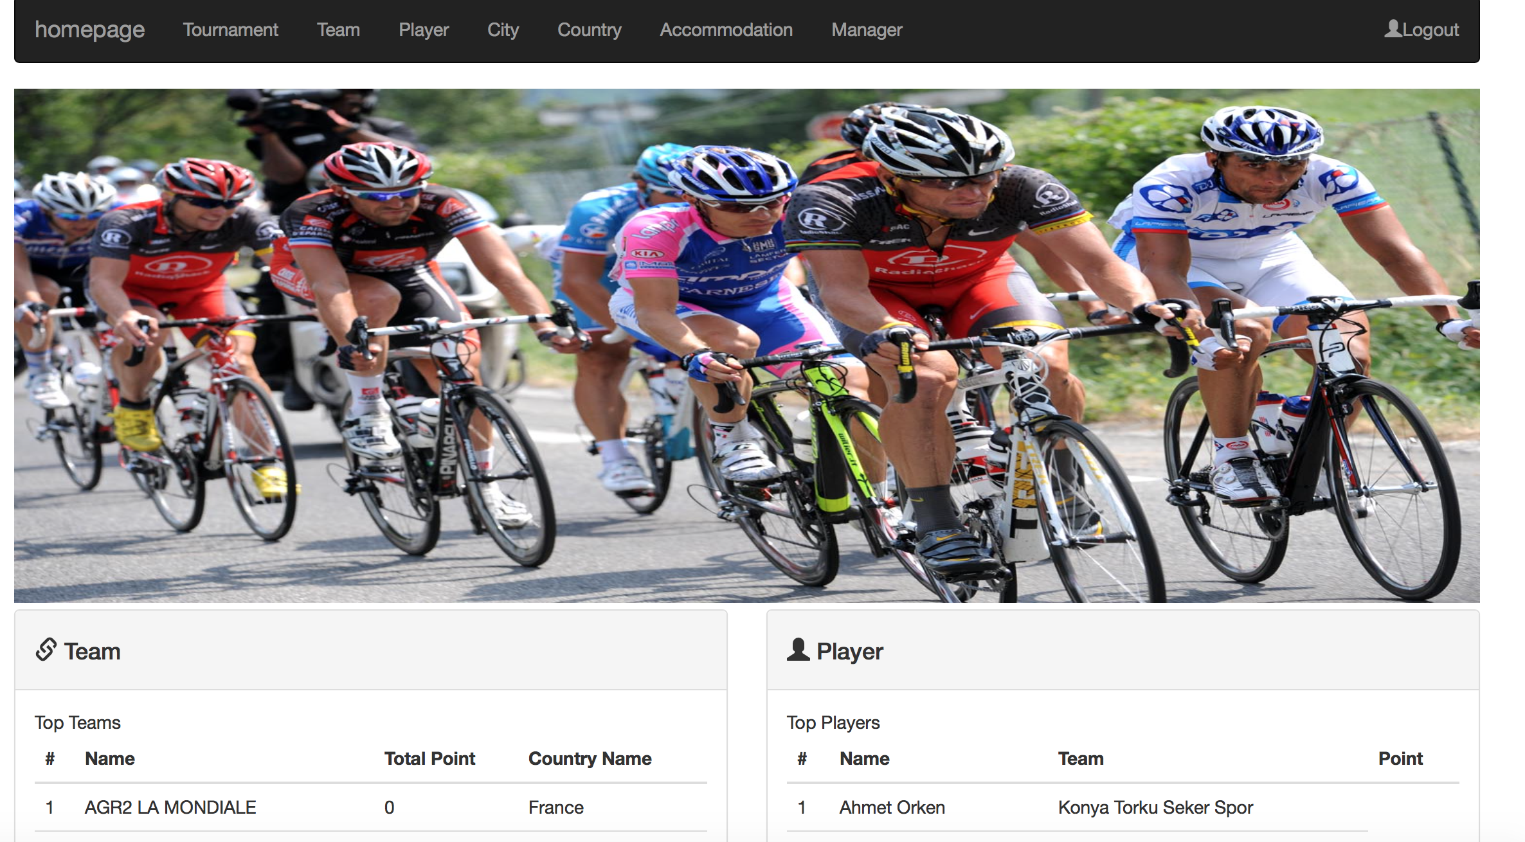
LOGOUT
Admin logout by clicking
the Logout button on the top menu

Slide 23
FUNCTIONS
Add/Delete/Update functions for main tables are only allowed to administrators. Non-admin users also cannot show these operations in their view.

Slide 24
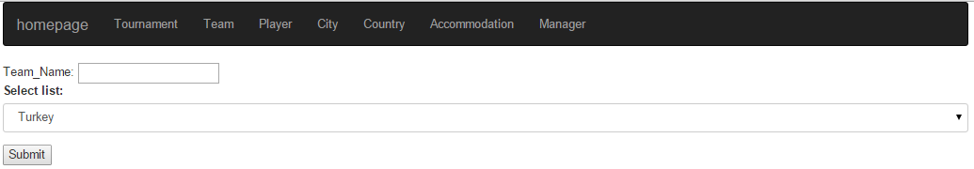
Add Function For Main Tables
To add data for a main table,click the "Add " link, then fill the text area for name and select additional from the drop-down list (if required), then click the "Submit" button.

Slide 25
Delete Function For Main Tables
To delete data from a main table, simply click the "Delete" link in the same row of the related data.

Slide 26
Update Function For Main Tables
To update data from a main table, click the "Update" link in the same row of the related information. Note that update operation only changes the name, it cannot change the id number.

Slide 27
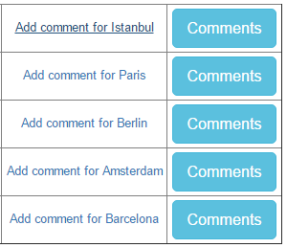
Add Comment Function For Main Tables
To add a comment, click the "Add Comment" link in the same row of the related data. Write the comment in the text area and and click "Submit" button.

Slide 28
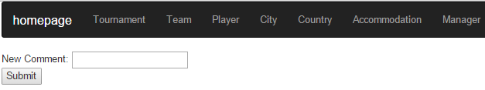
Add Comment Function For Main Tables
To add a comment, click the "Add Comment" link in the same row of the related data. Write the comment in the text area and and click "Submit" button.

Slide 29
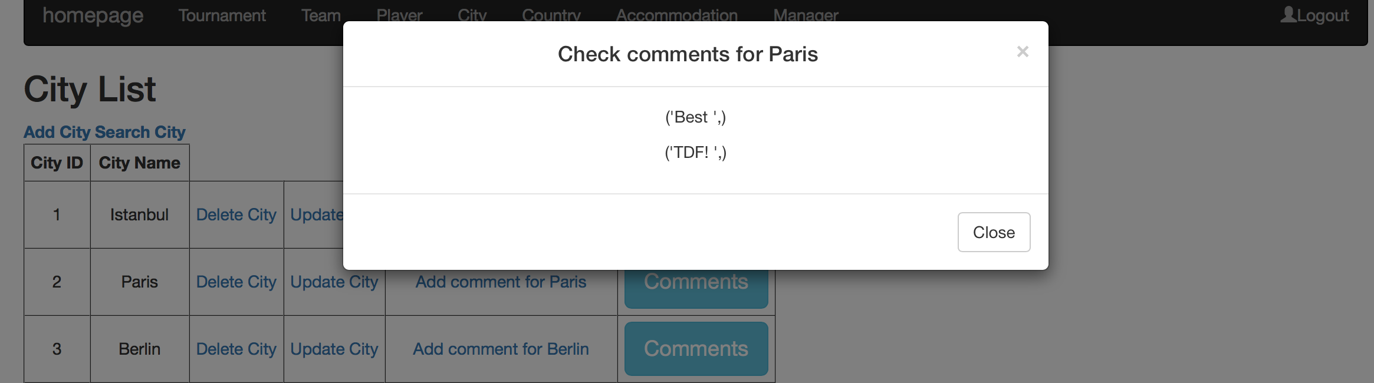
View Comment Function For Main Tables
To view comments, click the "Comments" button in the same row of the related data.

Slide 30
Database Design
The database that created for CYCLING project consist of 13 tables.
Player
Player Comment
Team
Team Comment
Tournament
Tournament Comment
City
Country
Accommodation
Admin
Author
City Comment
Accommodation Comment

Slide 31
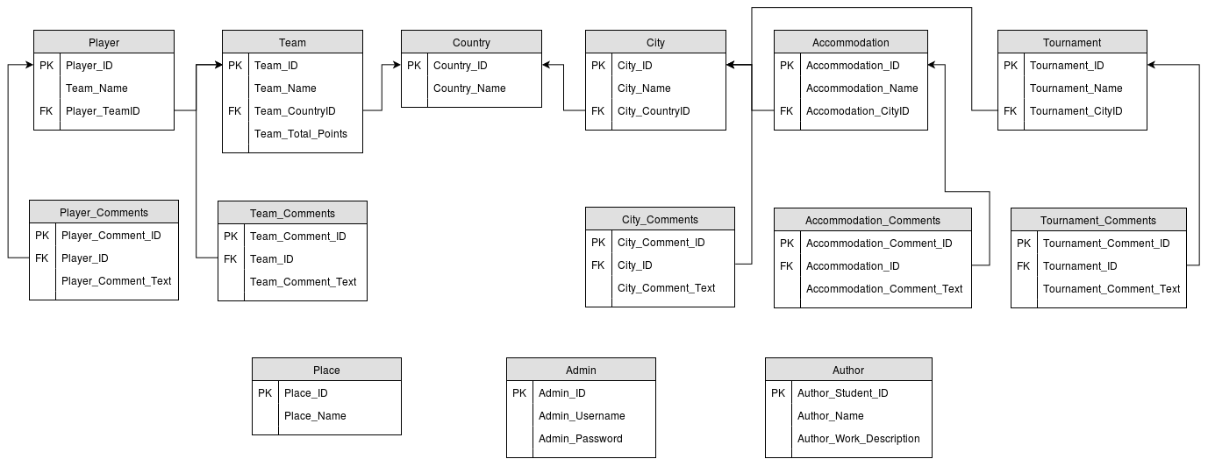
Entity Relationship Diagram

Slide 32
Table 1:City
Name | Type | Not Null | Primary Key
City_ID | Serial | 1 | 1
City_Name | Char | 1 | 0
City_CountryID | Int | 1 | 0
Tournament cities are located on this table.It has 3 attributes and 1 primary key and 1 foreign key.
City_ID: Keeps the id number of the city.
City_Name: Keeps name of the city in char type.
City_CountryID: Foreign key. It associates country with the city

Slide 33
Table 2:City Comment
Name | Type | Not Null | Primary Key
City_CommentID | Serial | 1 | 1
City_ID | Char | 1 | 0
City_Comment_Text | Char | 1 | 0
City comments are located on this table.It has 3 attributes and 1 primary key and 1 foreign key.
City_CommentID: Keeps the id number of the City Comment.
City_ID: Foreign key. It associates city comments with the city.
City_Comment_Text: Keeps the comment of the city.

Slide 34
Table 3:Country
Name | Type | Not Null | Primary Key
Country_ID | Serial | 1 | 1
Country_Name | Char | 1 | 0
Tournament city countries are located on this table.It has 2 attributes and 1 primary key and Country_Name.
Country_ID: Keeps the id number of the country.
Country_Name: Keeps name of the country in char type.

Slide 35
Table 4:Accommodation
Name | Type | Not Null | Primary Key
Accommodation_ID | Serial | 1 | 1
Accommodation_Name | Char | 1 | 0
Accommodation_CityID | Int | 1 | 0
Tournament accommodations are located on this table.It has 3 attributes and 1 primary key and 1 foreign key.
Accommodation_ID: Keeps the id number of the accommodation .
Accommodation_Name: Keeps name of the hotel in char type.
Accommodation_CityID: Foreign key. It associates city with the hotel.

Slide 36
Table 5:Accommodation Comments
Name | Type | Not Null | Primary Key
Accommodation_Comment_ID | Serial | 1 | 1
Accommodation_ID | Int | 1 | 0
Accommodation_Comment_Text | Char | 1 | 0
Tournament accommodations comments are located on this table.It has 3 attributes and 1 is primary key.
Accommodation_Comment_ID: Keeps the id number of the accommodation comments.
Accommodation_ID: Foreign key. It associates city comments with the city.
Accommodation_Comment_Text:Keeps the comment of the hotel.

Slide 37
Table 6:Team
Name | Type | Not Null | Primary Key
Team_ID | Serial | 1 | 1
Team_Name | Char | 1 | 0
Team_CountryID | Int | 1 | 0
Team_Total_Points | Int | 0 | 0
Information about teams are located on this table.It has 4 attributes and 1 is primary key.
Team_ID: Keeps the id number of the team.
Team_Name: Keeps the name of the theam.
Team_CountryID:Keeps the Country information about the team. Foreign key.
Team_Total_Points:Keeps the team tournament points

Slide 38
Table 7:Team Comments
Name | Type | Not Null | Primary Key
Team_Comment_ID | Serial | 1 | 1
Team_ID | Int | 1 | 0
Team_Comment_Text | Char | 1 | 0
Team comments are located on this table.It has 3 attributes and 1 is primary key.
Team_Comment_ID: Keeps the id number of the team comments.
Team_ID: Foreign key. It associates team comments with the team itself.
Team_Comment_Text:Keeps the comment of the team.

Slide 39
Table 8:Player
Name | Type | Not Null | Primary Key
Player_ID | Serial | 1 | 1
Player_Name | Char | 1 | 0
Player_TeamID | Int | 1 | 0
Team players are located on this table.It has 3 attributes and 1 primary key and 1 foreign key.
Player_ID: Keeps the id number of the player.
Player_Name: Keeps name of the playerin char type.
Player_TeamID: Foreign key. It associates team with the player.

Slide 40
Table 9:Player Comments
Name | Type | Not Null | Primary Key
Player_Comment_ID | Serial | 1 | 1
Player_ID | Int | 1 | 0
Player_Comment_Text | Char | 1 | 0
Player comments are located on this table.It has 3 attributes and 1 is primary key.
Player_Comment_ID: Keeps the id number of the player comments.
Player_ID: Foreign key. It associates team comments with the player itself.
Player_Comment_Text:Keeps the comment of the player.

Slide 41
Table 10:Tournament
Name | Type | Not Null | Primary Key
Tournament_ID | Serial | 1 | 1
Tournament_Name | Char | 1 | 0
Tournament_CityID | Int | 1 | 0
Tournaments are located on this table.It has 3 attributes and 1 primary key and 1 foreign key.
Tournament_ID: Keeps the id number of the Tournament.
Tournament_Name: Keeps name of the tournament name in char type.
Tournament_CityID: Foreign key. It associates city with the tournaments.

Slide 42
Table 11:Tournament Comments
Name | Type | Not Null | Primary Key
Tournament_Comment_ID | Serial | 1 | 1
Tournament_ID | Int | 1 | 0
Tournament_Comment_Text | Char | 1 | 0
Tournament comments are located on this table.It has 3 attributes and 1 is primary key.
Tournament_Comment_ID: Keeps the id number of the tournament comments.
Tournament_ID: Foreign key. It associates tournament comments with the tournament itself.
Tournament_Comment_Text:Keeps the comment of the tournament.

Slide 43
Table 12:Author
Name | Type | Not Null | Primary Key
Author_ID | Serial | 1 | 1
Author_Name | Char | 1 | 0
Author_Work_Description | Int | 1 | 0
Authors are located on this table.It has 3 attributes and 1 primary key and 1 foreign key.
Author_ID: Keeps the id number of the Author.
Author_Name: Keeps name of the author name in char type.
Author_Work_Description:It shows work description of the Author

Slide 44
Table 13:Admin
Name | Type | Not Null | Primary Key
Admin_ID | Serial | 1 | 1
Admin_Username | Char | 1 | 0
Admin_Password | Char | 1 | 0
Admin are located on this table.It has 3 attributes and 1 primary key and 1 foreign key.
Admin_ID: Keeps the id number of the Admin.
Admin_Username: Keeps username of the admin in char type.
Admin_Password :Keeps password of the admin in char type.

